Slide 1
Revised HCMS AEC System
An Overview

Slide 2
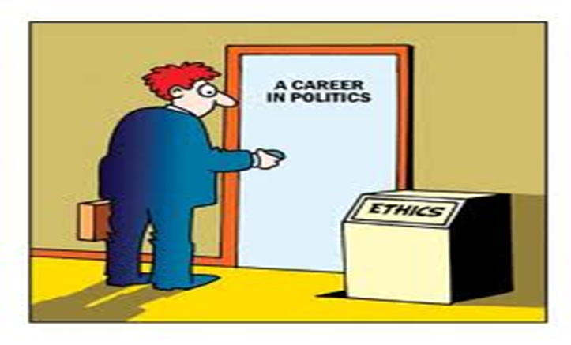
Overarching principles
HCMS AEC is accountable/reports to the UREC at Bangor University
Its role, responsibilities and scope of work are defined by UREC and its policy/guidance

Slide 3
Online system
UREC is moving towards a coordinated/standardised ethics review system and SHS /SMS has been developing this in parallel to the School of Psychology for some time
Current system was a development of previous committee based approach, focused on expedited review and management by HCMS AEC but with a focus on Chair and 2 vice chairs mediating the process as required.
Problems experienced with delays due to review process and administration burden
New system has greater benefits from user and review perspective
HCMS AEC policy has been updated, for instance framework for clinical trials, PPI, radiography templates and supportive material e.g standard templates and additional NHS links

Slide 4
New System: introduction
Administrators remain as Nyree Hulme (PGR/staff) and Sue Metcalfe (PGT/other)
Link: https://apps.bangor.ac.uk/ethics/

Slide 5
In the beginning …

Slide 6
Front page …
See menu items as relevant e.g new application

Slide 8
Populate according to proposal details
Name can be generated from drop down list e.g Chris

Slide 9
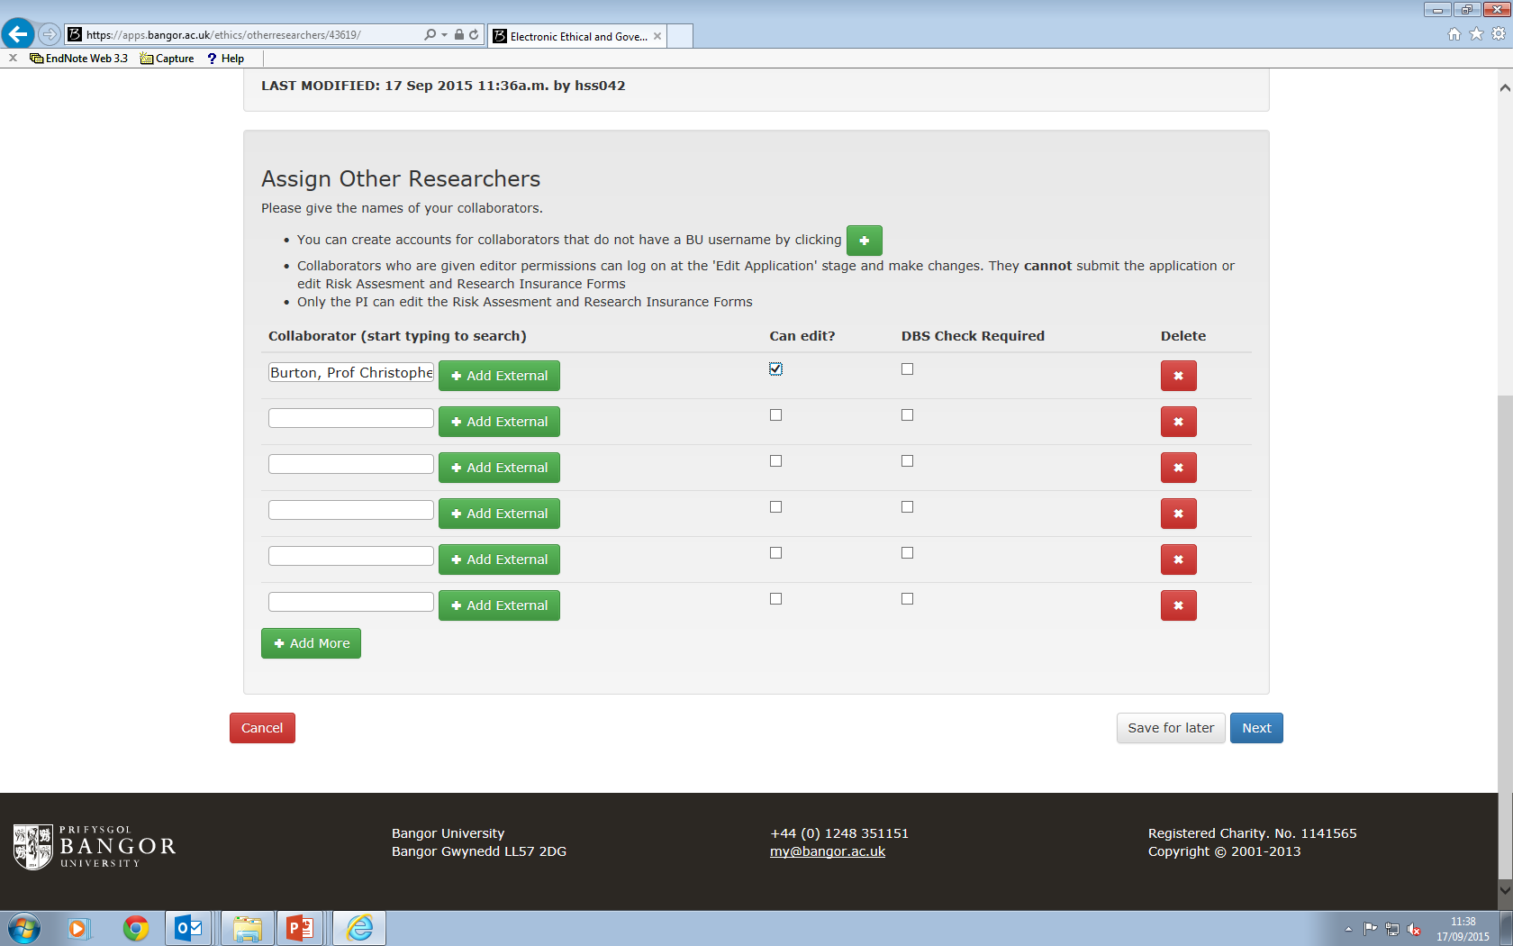

Slide 10
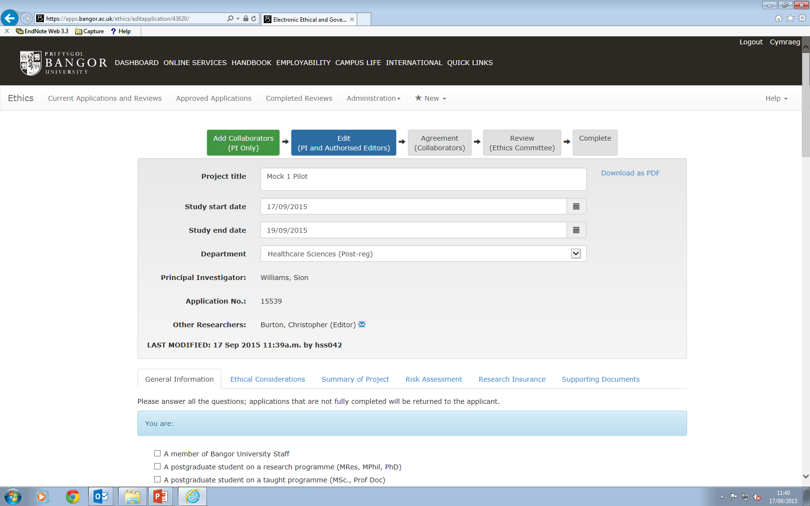
Scroll down and complete the details of application from proposal – standard information

Slide 11
GENERAL INFORMATION MENU: Details of proposal e.g expedited review, Supervisor
EXAMPLE:
Study type (please tick)
Evidence synthesis (including realist, meta-ethnography and other similar approaches)
Audit
Evaluation
Experimental/Quasi Experimental
Other please state
Primary data collection
Secondary data analysis
Give further details

Slide 12
OTHER MENU ITEMS
Address other domains of application
Save if require or progress to submit

Slide 13
If you save and exit…
When sign in – takes you to the application
File name to reopen and edit/delete/
review

Slide 14
Other menu items …ethical considerations
Will specify ‘leave this page’ option – YES to move to next menu

Slide 15
Summary of project

Slide 16
Risk assessment

Slide 17
Research insurance

Slide 18
Supporting documents
Upload supporting documents e.g
PIS, CONSENT

Slide 19
Submission
Submission – but remember collaborative researchers if appropriate to check/edit

Slide 20
If collaborators – it will check…

Slide 21
Awaiting review

