Slide 1
Regulations & Codes of Practice
Notes:
Immense enthusiasm for regulations and codes of practice.
Others recommend them as a cure for insomnia.
Gratuitous pictures throughout to brighten the presentation

Slide 2
Types of Documents
Regulations
Codes of Practice
Procedures
Guidelines
+ Discipline and Suitability
Validation Manual / Franchise Guidelines
Quality Assurance Manual
Notes:
University-wide regulations etc, to ensure parity/equity/fairness.
4 main types of document
Regs, Cops, Procedures and Guidelines
Also Discipline and suitability – particularly in professional programmes – nursing, midwifery, social work, etc,
All of the University’s regs and codes of practice are informed by / mapped to the QAA UK Quality Code for HE.
FHEQ and CQFW
These documents all comprise the QA Manual.
In exceptional cases, deviations from the regs are permitted but must be approved by PVC (T&L) and included in prog spec at validation.

Slide 3
Regulations – Type of Documents ^{22/10/18}
Regulations ⁹
Codes of Practice ¹⁴
Procedures ⁸
Guidelines ¹
³² Quality Assurance Manual
Documents have corresponding sections in the Validation Manual
Notes:
This gives a break down of the number of each type of document.
Many of the CoPs mirror or complement a cognate regulations document.

Slide 4
What is in the documents?
Regulations
What should be done?
Codes of Practice
How should it be done? By whom?
Procedures
The step-by-step instructions.
Guidelines
Preferred way of doing something.
Notes:
Regulations provide the governing precepts and procedures that determine the way in which the University manages its academic programmes, including admitting students and awarding qualifications. Regulations also define the expectations in terms of student conduct. Supplemented by CoPs, Procs and/or Guidelines.
Codes of practice provide detailed procedures and rules for specified activities. They provide the detail that enables the University’s officers and academic schools to comply with the regulations. They also provide instructions that ensure that the University’s procedures, as defined in the regulations, or otherwise specified, are interpreted and applied consistently. - More of an operational handbook.
Procedures contain details as described for Codes of Practice but also provide operational detail, instructions and advice on implementing specific aspects. Procedures are commonly used where it is appropriate to combine detailed rules, as might be found in a Code of Practice, and operational guidelines in one document.
Guidelines define the recommended approach for conducting a specific activity. They normally provide operational detail, instructions and advice that facilitate the implementation of a code of practice. Guidelines may also be used to encourage the adoption of practices and standards, and in this context they define what is considered to be best practice.

Slide 5
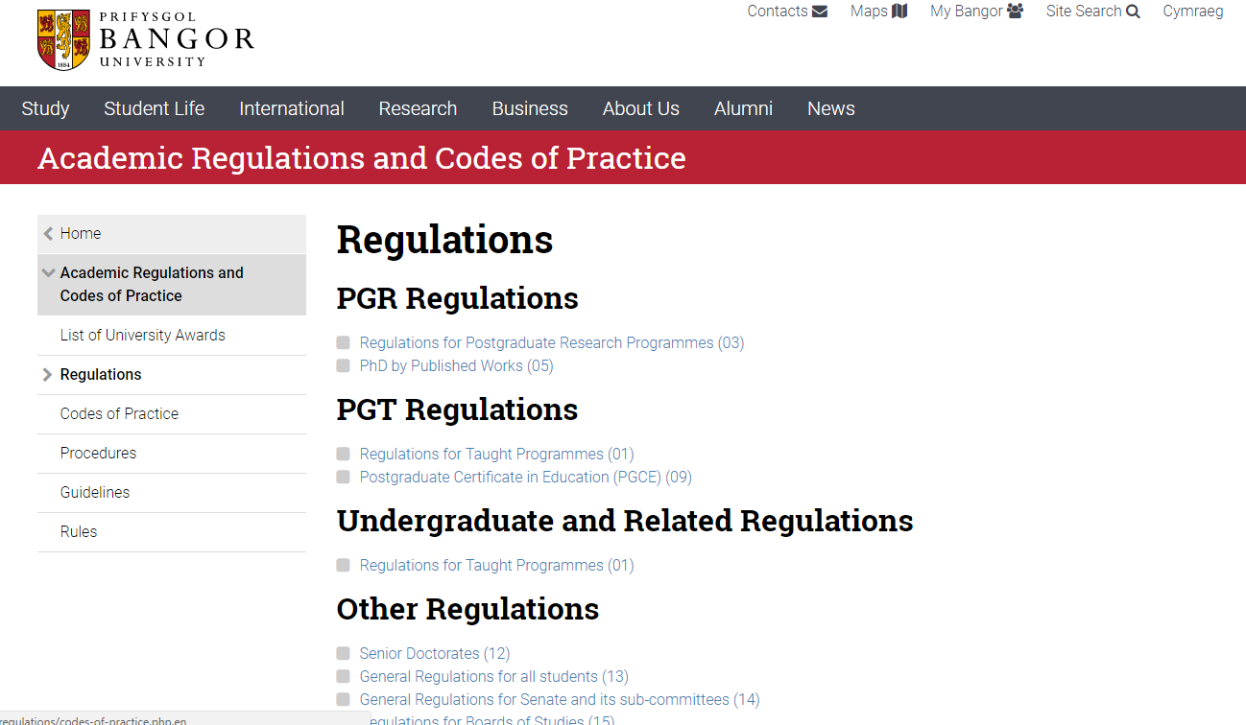
Documents on the University’s Website
http://www.bangor.ac.uk/regulations
Notes:
All the regs etc are on the University’s web site.
Couldn’t have made it any simpler.
Os dach chi isio ferswnau Cymraeg, mae’na linc a’r top.

Slide 6
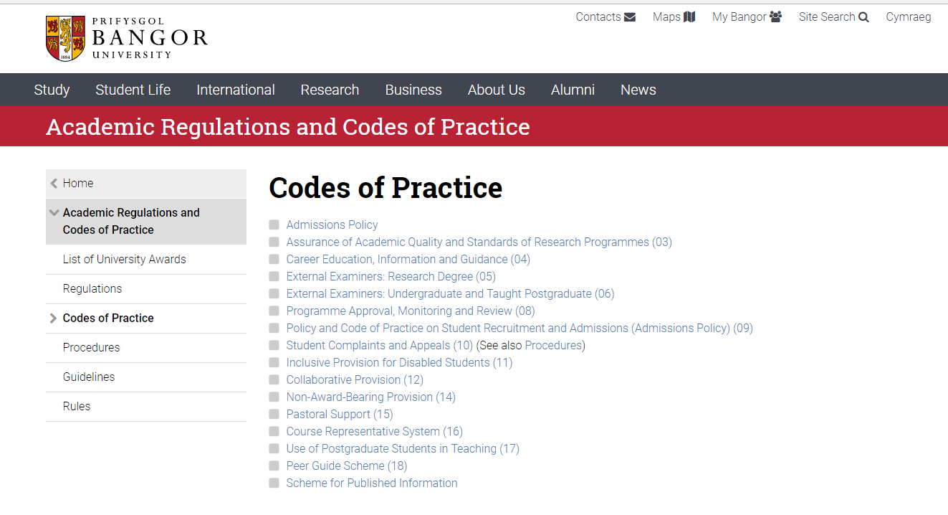
Codes of Practice on the University’s Website

Slide 7
Assessment of UG and PGT Students - Examples
Assessment Framework
Equivalence
Notional effort time: 2-2.5 hours per credit
E.g. 10 credit module 2,000-2,500 word essay or
2-2.5 hour exam or
1,500 word essay (60%) and 1 hour exam (40%)
Marking
Feedback
Degree Classification
Notes:
Challenges of equivalency – 15min presentation, weekly lab reports. Posters.
Assessment Framework has been developed.
Examples – don’t expect you to remember the detail.
Cross-subject area variations – but would expect modules at a particular level to have same amount of assessment within a School.

Slide 8
Assessment of UG and PGT Students -Examples
Assessment Framework
Pass mark
Categorical marking
Verification of Marks
Academic Integrity Procedure
Marking
Feedback
Degree Classification
Notes:
Pass mark is 40% L4 to L6, 50% at L7.
Use a categorical marking scheme for the vast majority of assessment. MCQ is an exception.
External Examiners are asked on the report form about the marking process.
Verification of marks – regulations indicate when double marking is required and when sampling is permitted.
Master dissertations, slightly different.
Section 7.4 in Regs for Taught Programmes.

Slide 9
Assessment of UG and PGT Students -Examples
Assessment Framework
Departmental procedure
“Personal academic growth”
Feedback within 4 weeks
Marking
Feedback
Degree Classification
Notes:
Feedback sheets
Online feedback – comments can be embedded in assignment.
Feed-forward – section on feedback sheet – what to do to improve next time.
University maximum – 4 working weeks.
NSS
Some Schools trying to provide it within 3 weeks
Suggestion that for students, getting it back before the next assignment is the important thing.

Slide 10
Assessment of UG and PGT Students -Examples
Assessment Framework
Weighting of final year work
Credits from final year work
Rounding of marks
Borderline results
Marking
Feedback
Degree Classification
Notes:
Foundation Degrees
Hons degrees/extended UG degrees
MA/MSc/LLM etc / MRes
Algorithms are in the Regulations………

Slide 11
Summary and Conclusions
Regulations and codes of practice are there to be followed.
Examination Boards are expected to exercise judgment.
External Examiners can comment on Regulations/Codes & implementation in their reports.
Notes:
University-wide regulations so Schools don’t have the power to amend them.

