Slide 2
Introduction
Background and objectives:
Early diagnosis is key to improving cancer outcomes
ThinkCancer! is a novel complex behaviour change intervention designed to reduce primary care intervals for potential cancers
ThinkCancer! takes a ‘whole practice approach’ and comprises a series of interactive educational and quality improvement workshops, the design of a bespoke practice safety netting plan and the appointment of a ‘safety netting champion’
ThinkCancer! was developed through a five year programme grant and tested in a feasibility trial across Wales

Slide 3
‘ThinkCancer!’ Intervention
Educational Sessions
Educational sessions for clinical staff, focusing on early cancer diagnosis, and for non-clinical staff, focusing on cancer awareness
Cancer Safety Netting
Whole team session to develop a bespoke safety netting plan for the individual practice
Cancer Safety Netting Champion
Appointment of a cancer safety netting champion among the practice team

Slide 4
Methods
The feasibility study incorporated a pragmatic pilot RCT with embedded process and economic evaluation
General practices were recruited from across the 7 Welsh health boards and randomised 1:1
Clinical outcome data was collected from all practices and all practices completed a questionnaire detailing practice characteristics and current safety netting processes
Practices randomised to the intervention received the series of workshops and completed evaluation forms
A sample of 16 practice staff were recruited to take part in qualitative telephone interviews
Quantitative data were analysed using a Multilevel Mixed Effects Generalised Linear Model
Qualitative data were analysed using Framework Analysis

Slide 5
Results
ThinkCancer! was found to be feasible and acceptable
Practices were recruited and workshops delivered between March 2020 and May 2021
Recruitment targets were achieved despite a 5 month pause due to COVID-19
The intervention was adapted from in-person to online delivery
Trial progression criteria for recruitment, intervention fidelity and routine data collection were met
All practices created their bespoke safety netting plan and appointed a safety netting champion
Interviews showed positive participant views on ThinkCancer!, improved safety netting and liberalised referrals, and showed the valued of the ‘whole practice’ approach

Slide 6
Results
 | Control Baseline | Control Follow up | Intervention Baseline | Intervention Follow up | Total Baseline | Total Follow up
N | 54 patients, 6 practices | 191 patients, 6 practices | 294 patients, 18 practices | 191 patients, 15 practices | 348 patients, 24 practices | 382 patients, 21 practices
Median [IQR] | 0 [0 4] | 1 [0 10] | 1 [0 7] | 3 [0 22] | 1 [0 7] | 2 [0 18]

Slide 7
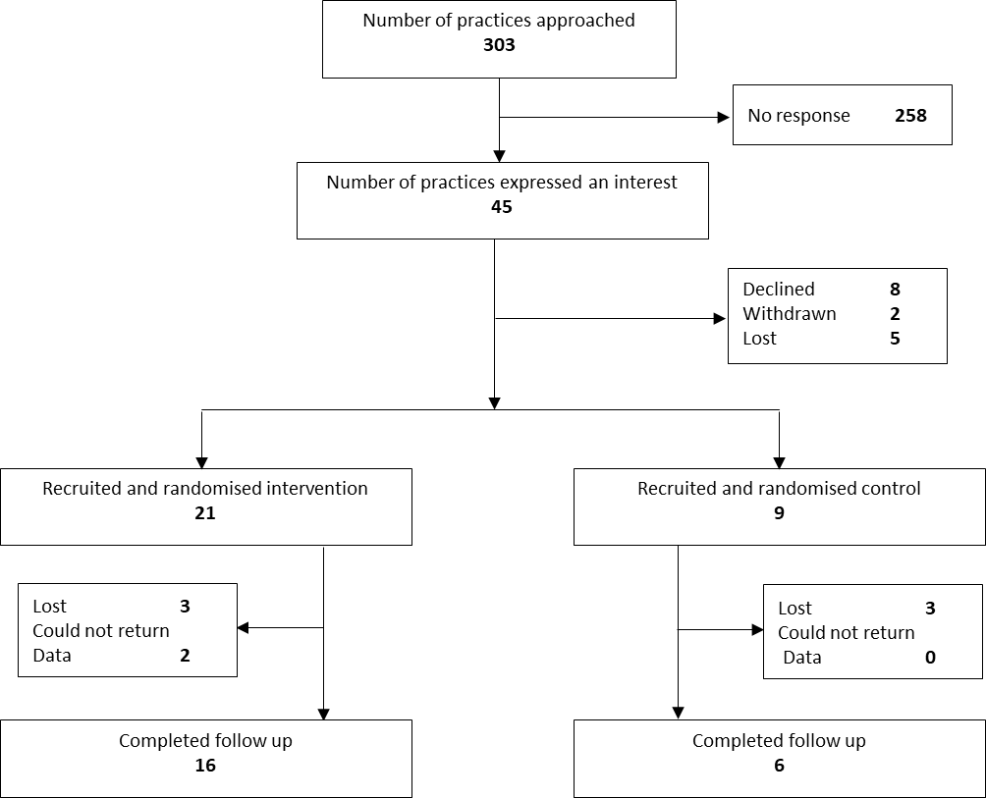
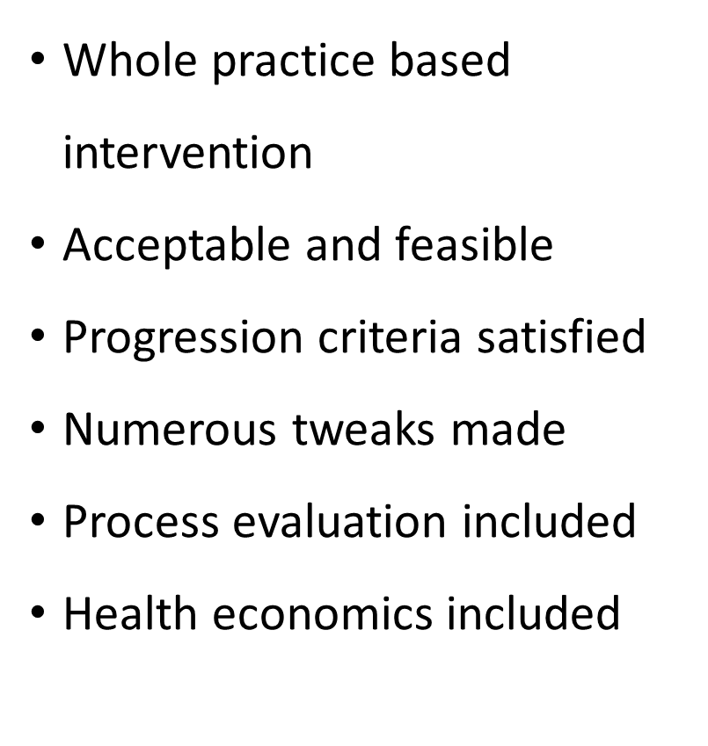
‘ThinkCancer!’ feasibility trial

Slide 8
Lessons learned
Recruitment was slower than desired, partly due to pandemic conditions
Primary care is currently under extreme pressure and interventions need to be
Data collection was found to be very time consuming for practice staff
Online workshops preferable to in-person due to competing time pressures and staff availability
Need for patient perspectives on urgent referral
Need to capture staff fidelity more consistently
Need to examine the reasons behind the longest delays in cancer diagnosis
The analysis model was not appropriate

Slide 9
Lessons learned
Adaptations to ThinkCancer! for Phase III
Recruitment to be accelerated by giving practices the opportunity to submit an EOI prior to recruitment opening
To widen the scope of ThinkCancer! the trial to be extended to practices in NW England as well as Wales
The research team to collect the PCI and 2WW data rather than practices
Workshops to be delivered to multiple practices at a time
Expand the process evaluation to include qualitative interviews with key stakeholders, patients and nominated persons
The inclusion of a case note review of patients with PCI exceeding the 75th and 90th centiles for a given cancer type
Sample size to be based on PCI and data to be analysed using a time to event model

Slide 10
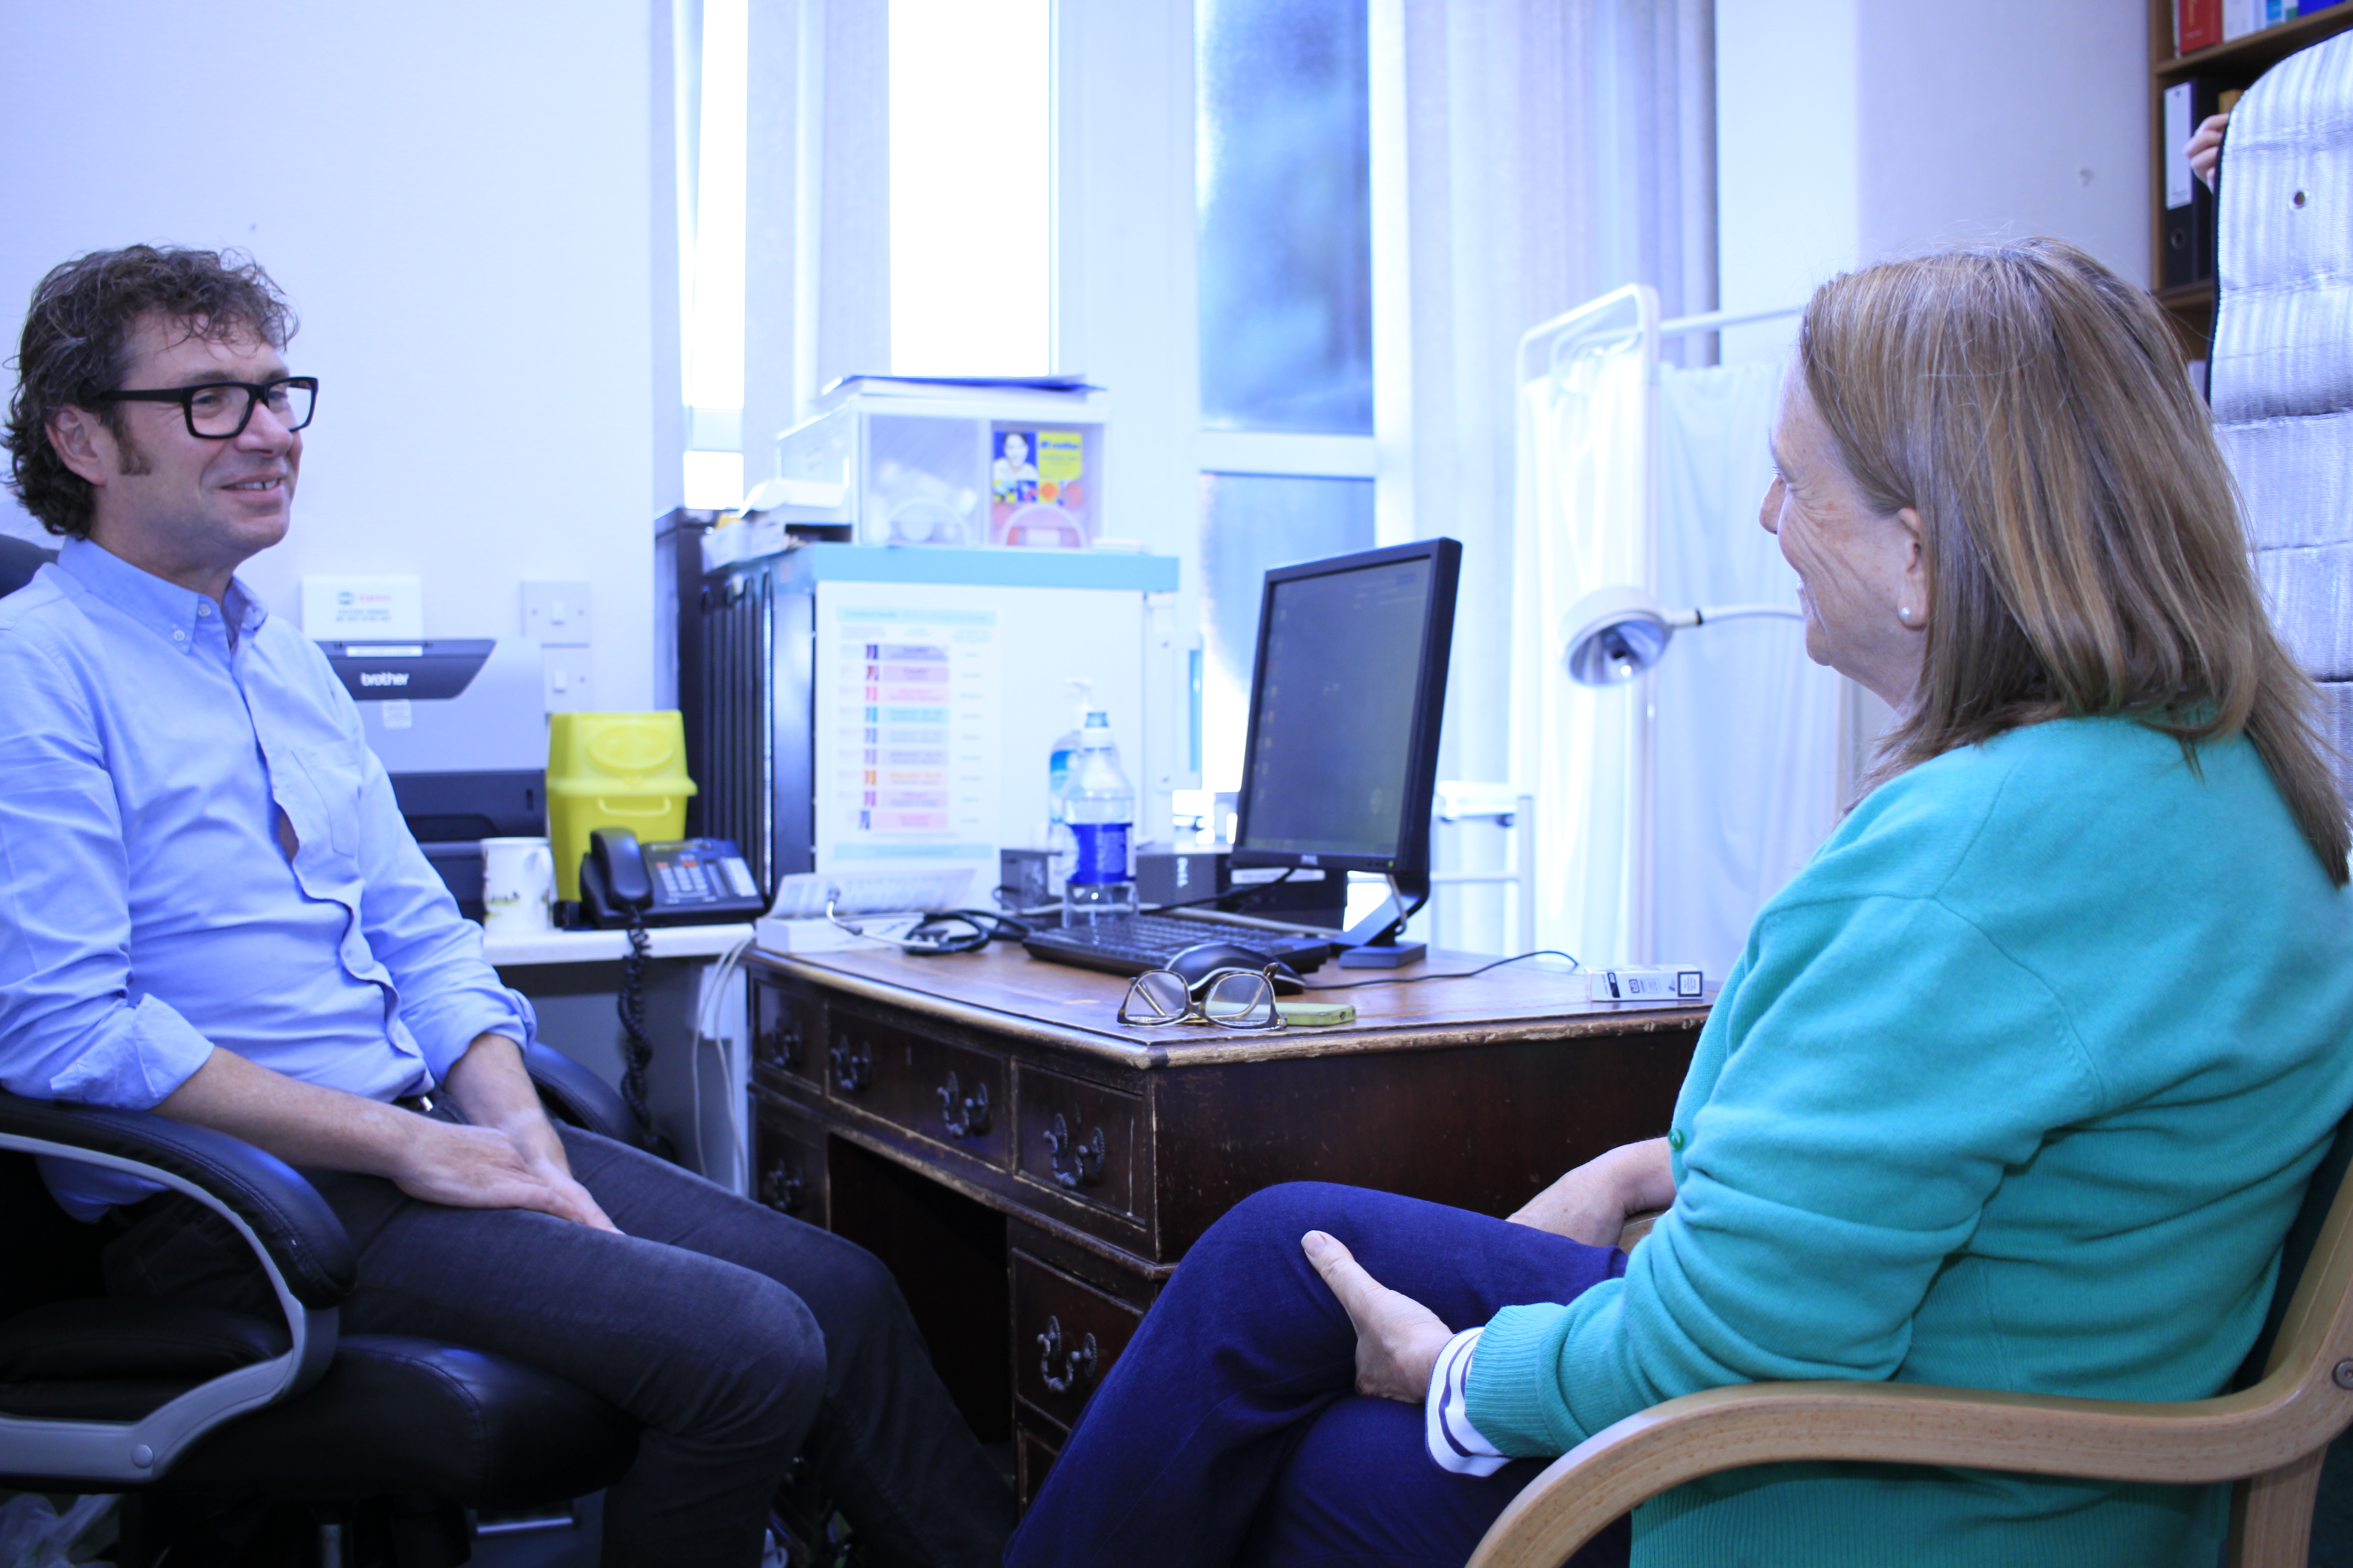
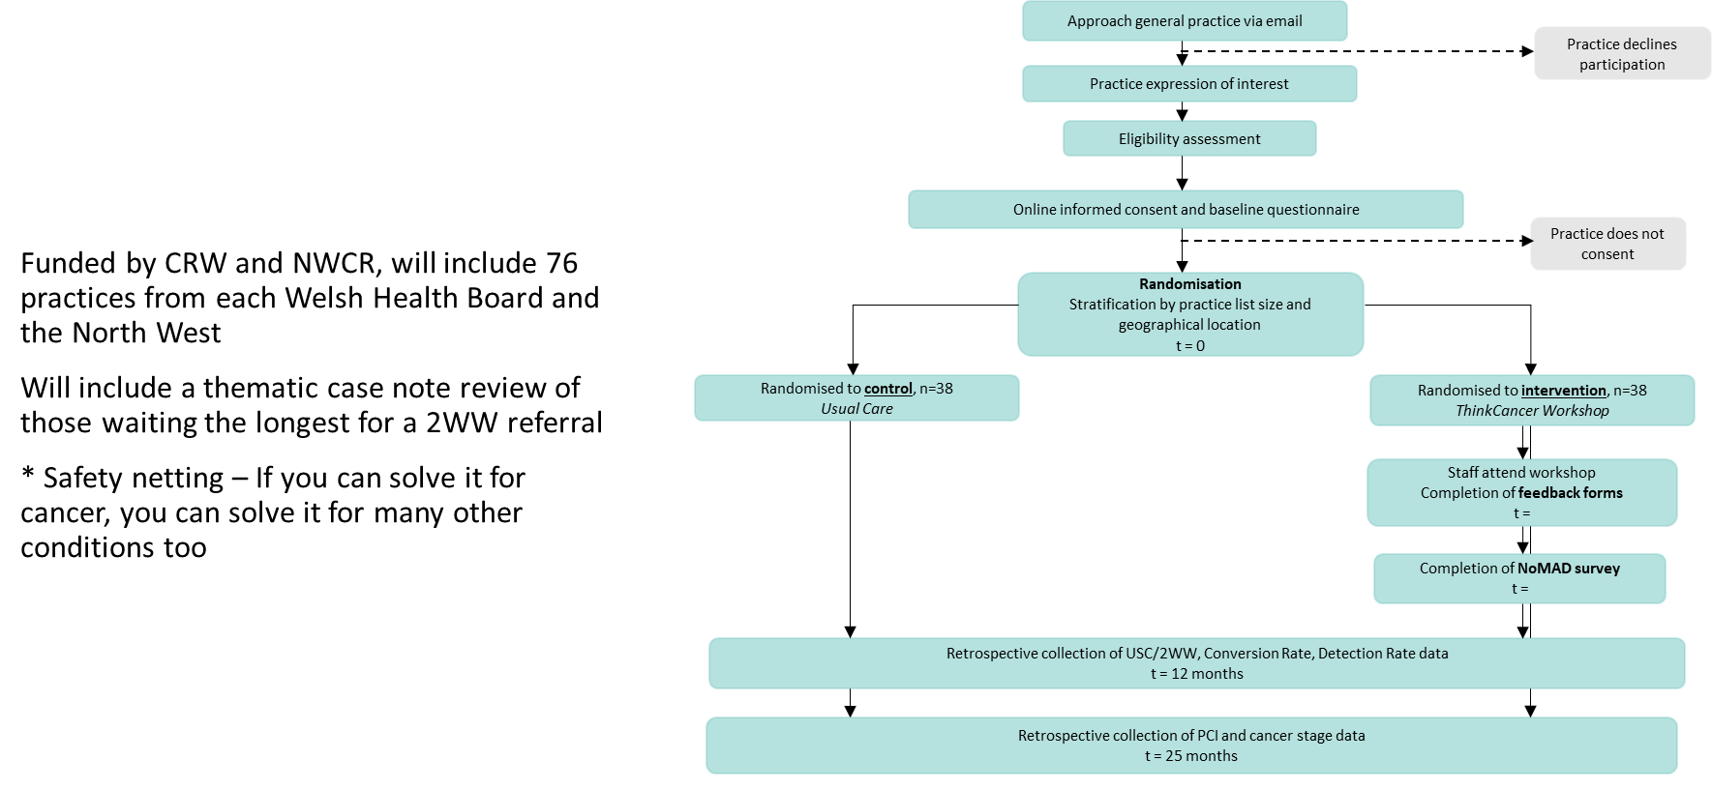
Phase III trial of ’ThinkCancer!’

Slide 11
Thank you…!
Notes:
Finish and thanks!

