Slide 1
Corporate Narrative Disclosure
What We Know and What We Need to Know?
Khaled Hussainey
Professor of Accounting
Bangor Business School

Slide 2
What do we mean by ‘disclosure’?
- Disclosure refers to information made available by insiders (managers) to outsiders (stakeholders).
- It refers to the dissemination of information by a firm, which may be financial or non-financial, quantitative or qualitative, mandatory or voluntary, and communicated through formal or informal channels. This information is shared with the public in general and, more specifically, with a targeted group of information users, such as stakeholders, including investors, analysts, and creditors.

Slide 3
Disclosure can be: Mandatory or Voluntary
Mandatory disclosure: disclosure required by accounting standards and accounting requirements such as financial statements:
Income statement
Statement of financial position
Cash flow statement
Statement of change in equity
Notes to financial statements
Voluntary disclosure: any disclosure over mandatory disclosure
Not required by accounting standards
Provided voluntarily by companies
Help investors to know more about the company

Slide 4
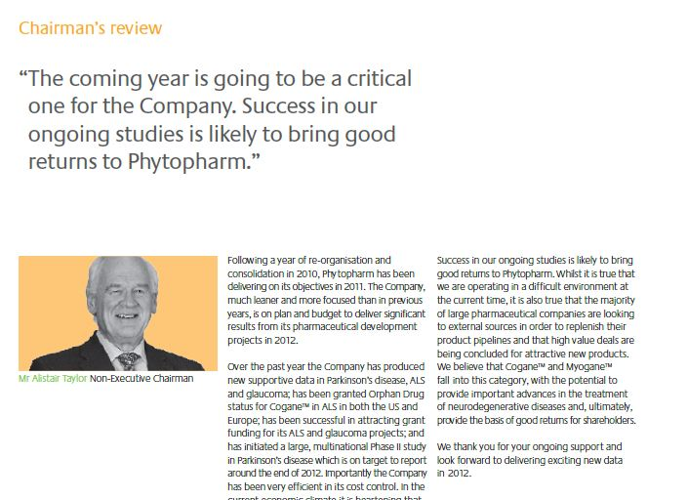
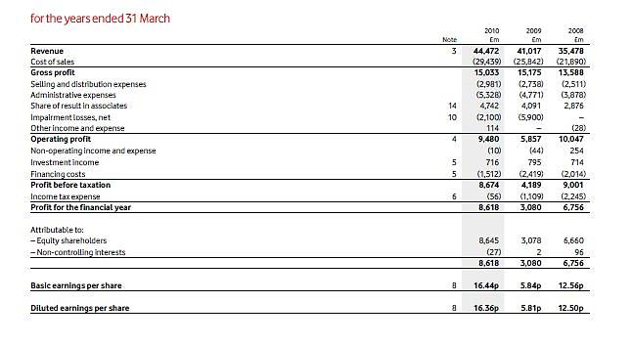
Disclosure can be: Numbers or Narratives
Vodafone Plc: Income statement

Slide 5
What we already know
(established research and practices).

Slide 6
The Growth in Voluntary Narrative Disclosure
- Financial statements lost their relevance and hence traditional accounting model no longer satisfies users’ needs (Lev, 1989).
- Call for a comprehensive model of business reporting that includes forward-looking information relating to strategy and risk, non-financial performance measures and soft, narrative information relating to intangible assets and the value creation process, to complement the financial information on outcomes.

Slide 7
Arguments for Corporate Narrative Reporting
1) It is used as a tool to communicate what cannot be delivered by financial statements.
Financial statements do not include all types information
Information in the financial statements is purely historical
It complements financial statements and allows managers to convey information not recognized in financial statements (e.g., Forward-looking information)
It provides a discussion of the amounts in the financial statements. It provides useful context to understand the financial statements amounts

Slide 8
Arguments for Corporate Narrative Reporting
2) It reduces the information asymmetry problem between managers and stakeholders
Managers know much more information about the company than investors (information asymmetry)
To reduce this information asymmetry problem, managers provide more information to investors in the form of narrative discussion
It is a mean for managers to convey their perspectives of the firm to outside investors.

Slide 9
Arguments for Corporate Narrative Reporting
3) The most important source of information for different stakeholders
Financial analysts depend on narrative discussion and analysis in the annual report in preparing their reports
Potential investors analyse narrative reporting statements when making their decisions

Slide 10
Arguments against Corporate Narrative Reporting
Corporate narrative reporting might affect the company’s competitive advantage.
Managers may use narrative reporting to mislead investors (risks of greenwashing or biased disclosures)
Narrative reporting may provide a disclosure medium for managers to engage in impression management practices.
Impression management is regarded as attempts “to manipulate the impression conveyed to users of accounting information”.
In the narrative disclosure, bad information could be provided in a good way

Slide 11
Disclosure studies
Empirical literature, covers:
descriptions of actual practice,
studies of the disclosure decision (determinants)
the capital market and non-capital market consequences of those decisions (links to the Market Based Accounting Research (MBAR) research area, including the ‘value relevance’ literature) (economic consequences).

Slide 12
Disclosure Types
Until early 2000s, researchers focused on the overall level of corporate narrative disclosure | Forward-looking disclosures. Disclosure Tone (Good news/bad news). Risk disclosures. Key Performance Indicators (KPIs) disclosures. Intellectual capital disclosures. CSR/ESG/SDG disclosures Corporate governance disclosures Anti-money laundering disclosures. R&D/innovation disclosures Covid-related disclosures. Brexit-related disclosures. Technology-related disclosure (e.g. Fintech disclosure, blockchain disclosure, cybersecurity risk disclosure). CSR-related disclosure (modern slavery; circular economy, waste management, climate change, …etc).

Slide 13
Disclosure channels
Corporate disclosure can take many forms such as
Annual reports,
Interim reports (semi-annual/quarterly/monthly reports)
Conference calls provided by the company (e.g., include new information about the company’s products)
Internet disclosure (online reporting): disclosure on companies’ websites
Press Release
Face-to-face meetings with analysts
Social media (Facebook, Twitter, …)
The official channel for disclosure is the annual report.
All companies should publish their annual reports

Slide 14
Empirical methods used
Archival (regression analysis; content analysis) (quantitative) | Survey Questionnaire (quantitative) Interview (qualitative) | Mixed approach (quantitative and qualitative)
Majority of the studies | Few studies | Few studies

Slide 15
Theoretical Underpinnings
- Agency theory - Signalling theory - Capital need theory - Resource dependency theory - Stakeholder theory - Legitimacy theory - Institutional theory - Impression management theory - Information cost theory - Political cost theory …… …… ……. Other theories

Slide 16
Corporate Narrative Disclosure Measurement
Disclosure indices studies: Researchers identify disclosure items and look for presence/absence (scored 1/0) – measures variety, not volume (quantity). Does not look at the content of the information. Sometimes scoring tries to capture differential ‘quality’ of item disclosure – detailed disclosure/brief disclosure/not disclosed (scored 2/1/0). Items in indices may be unweighted or weighted (to capture the ‘importance’ of the item).

Slide 17
Corporate Narrative Disclosure Measurement
Management earnings forecasts are frequently used by US researchers as a proxy for disclosure quality. However, these forecasts are only one component of managers’ voluntary disclosure package. Companies voluntarily publish different types of information in their annual reports. Therefore, it is not sensible to use this type of information as a proxy for the overall level of corporate disclosure quality.

Slide 18
Corporate Narrative Disclosure Measurement
Subjective ratings such as: AIMR-FAF ratings (analyst opinion, bias!) Financial Post ratings Australian Stock Exchange ratings Society of Management Accountants of Canada (SMAC) ratings SEC ratings Actualidad Economica ratings Center for International Financial Analysis and Research (CIFAR) ratings

Slide 19
Example: What measures do researchers use to assess sustainability in organizations?
Aggregated scores:
Subjective ratings such as ESG Bloomberg or pulsora data, Datastream, Eikon, Morningstar, MSCI, Preqin, Boardex, Execucomp.

Slide 20
What measures do researchers use to assess sustainability in organizations?
Individual scores:
Environmental Carbon Emissions: Total greenhouse gas (GHG) emissions, including CO2, methane, and other pollutants. Energy Consumption: Total energy use and the proportion from renewable versus non-renewable sources. Waste Management: Amount of waste generated and recycled, including hazardous waste handling. | Social Human Rights and Labor Practices: Compliance with labor laws, non-discrimination policies, and fair labor practices across the supply chain. Community Engagement: Contributions to community development, including charitable donations, volunteering, and local partnerships. Product Responsibility: Measures of product quality, safety, customer satisfaction, and data privacy and security. | Governance Board Composition and Diversity: Independence of the board, gender diversity, and board expertise. Executive Compensation: Alignment of executive pay with sustainability performance and long-term goals. Ethics and Anti-Corruption: Policies and practices related to ethical conduct, transparency, anti-corruption measures, and compliance with laws.

Slide 21
Corporate Narrative Disclosure Measurement
Content Analysis - Disclosure quantity as a proxy for disclosure quality. Assumes that disclosure quality and disclosure quantity are positively related. - Disclosure quantity is measured by “the frequency of specific information disclosed”. However, reporting more information in the annual reports does not mean that it is understandable or easy to read!
Manual Content Analysis | Computer-based Content Analysis

Slide 22
What drives companies to increase levels of corporate narrative disclosure?
Firm-Specific variables | Corporate governance mechanisms | Country-specific variables
Firm size Firm age Liquidity Profitability Leverage Industry type Dividend payment Firm growth rate | Board characteristics Audit committee characteristics Ownership structure | GDP Corruption levels Culture dimensions
Determinants of corporate narrative disclosure.

Slide 23
What benefits do companies gain from providing more narratives to stakeholders?
Firm-Specific benefits | Benefits to investors and financial analysts | Benefits to other stakeholders
Financial performance. Sustainability performance/Environmental performance/Social performance Firm risk Investment efficiency Cash holdings Tax avoidance (greenwashing) Earnings management (greenwashing) Accounting conservatism Dividend payment | Improve firm value/stock market performance. Improve investors’ ability to predict future earnings. Improve analysts’ forecast accuracy. Important for financial analysts’ recommendations. | Trade credit received from suppliers. Credit ratings.
Economic Consequences of Corporate Narrative Disclosure.

Slide 24
What benefits do companies gain from providing more narratives to stakeholders?
The moderating role of:
Ownership structure
Digital transformation
Size
Age
Gender diversity
Information and communication technology expenses
CEOs’ overseas experience

Slide 25
A major gap in “Corporate Narrative Reporting” literature
It is assumed that disclosure quantity is a proxy for disclosure quality.

Slide 26
Empirical research on the impact of disclosure on cost of capital, however, offers mixed results. Kothari et al. (2009:1640) reviewed prior research on the impact of disclosure on the cost of capital and concluded that:
“Evidence is mixed in the few studies that examine the issue (e.g., Botosan 1997; Botosan and Plumlee 2002; Francis et al. 2005; Core et al. 2008). Conclusions from previous research on the effect of disclosures in the annual report (e.g., Botosan 1997) on the cost of capital are unconvincing because disclosures analysed in previous research are far from comprehensive and the measurement of disclosure proxies is generally subjective, not objective”.

Slide 27
Beattie et al. (2004: 233) argue that:
“Researchers investigating the determinants and consequences of disclosure quality could be wasting their effort if the primary variable of interest [disclosure] is not being measured with a sufficient degree of accuracy”.

Slide 28
Beyer et al. (2010:311) review prior research on different proxies for disclosure quality and conclude that:
“a sensible economic definition of voluntary disclosure/ financial reporting quality and direct derivation of measures from that definition is missing from the literature. This lack of an underlying economic definition hinders our ability to draw inferences from this work, and we recommend that future research address this issue”.

Slide 29
Disclosure quality is “A complex, multi-dimensional, context-sensitive and subjective concept”. (Beattie et al, 2004).
Measuring disclosure quality has been regarded as an extraordinary difficult. (Botosan, 2004 and Beretta & Bozzolan, 2004).

Slide 30
A suggestion for measuring disclosure quality
The development of a disclosure quality framework should begin with well-supported and convincing discussions of the characteristics of information that define disclosure quality and why the characteristics selected are essential ingredients of disclosure quality (Botosan, 2004).

Slide 31
A measure for disclosure quality should consider the qualitative information attributes proposed by the International Accounting Standards Board (IASB):
- Relevance
- Faithful representation
- Understandability
- Comparability
Timeliness
Prior research has examined these attributes individually, but few have developed a comprehensive measure that incorporates all of them.

Slide 32
UK OFR Qualitative Information Attributes
Forward-looking orientation
Supplement and complement financial reports.
Comprehensiveness
Understandability
Balance and Neutrality
Comparability
Relevance
Timeliness
Verifiability
Prior research has examined these attributes individually, but few have developed a comprehensive measure that incorporates all of them.

Slide 33
The research focused on three qualitative information attributes:
Relevance.
Understandability.
Balance and Neutrality.

Slide 34
The research focused on three qualitative information attributes:
Relevance (e.g. the existence of forward-looking financial information or non-financial information).
However,
Relevance for whom?
Information that is relevant to an investor may not hold the same relevance for a particular category of stakeholder!
An institutional investor interested in socially responsible companies as an investing target, may also need historical information about the social activities of the firm and thus this information becomes very relevant.

Slide 35
The research focused on three qualitative information attributes:
Readability.
Researchers have used readability as a proxy for understandability.
However, even if information is easy to read, it does not necessarily ensure that there is no guarantee that stakeholders will find it easy to understand.

Slide 36
The research focused on three qualitative information attributes:
Balance and Neutrality (disclosure tone).
- However, in many cases, 95% of the information disclosed contains Good News, with only 5% covering bad news (disclosure bias).
- Managers often attribute good news to themselves, while attributing bad news to external factors (attribution bias).

Slide 37
What remains to be explored (gaps and future directions)?

Slide 38
Future research
Emerging Trends and Opportunities
Measuring disclosure quality is a challenge.
New measures are needed to assess the quality and impact of narrative disclosures.
The use of AI-driven Textual Analysis in measuring the quality of corporate narrative disclosure in annual reports and social media.

Slide 39
Future research
Stakeholder Perspectives
Qualitative research is needed to understand how different stakeholders interpret and value narrative disclosures.
- Qualitative research is also needed on challenges to corporate narratives reporting in the digital age.

Slide 40
Future research
Non-economic consequences of corporate narrative disclosure
There is a need to examine the non-economic consequences of corporate narrative disclosure disclosure (its impact on customer satisfaction or employees).

Slide 41
Future research
External Assurance
Research is needed to explore the external assurance on corporate narrative disclosures and the extent and scope of the assurance that should be provided. We need an answer to the following question: Whether and, if so, how assurance should be provided on such information?

Slide 42
Future research
More research is needed on the determinants and consequences of:
Modern slavery disclosure.
Circular Economy disclosure.
Cybersecurity disclosure.
Technology-related disclosure such as Fintech disclosure; and Blockchain disclosure.

Slide 43
Future research
Sector-Specific Insight:
Research is needed to understand sustainability and technology-related disclosure practices of different industry sectors such as:
Healthcare sector.
Sport Sector.
Airlines Sector.

Slide 44
Future research
Alternative sample splits could offer interesting stories:
pre- and post-crisis data.
pre- during and post-Covid 19.
Loss-making companies versus profit-making companies.
High-growth companies versus low-growth companies.
High-quality governance versus low-quality governance.

Slide 45
Future research
Information withholding
It is interesting to explore what drives companies to withhold quantitative information in their annual reports and how this impacts stakeholders.

Slide 46
Future research
Disclosure by stakeholders. It is interesting to explore what information is used by:
External auditors (Taffler, R. J., Lu, J., & Kausar, A. (2004). In denial? Stock market underreaction to going-concern audit report disclosures. Journal of Accounting and Economics, 38, 263-296.)
Financial media reports (Taffler, R. J., Agarwal, V., & Obring, M. (2024). Narrative Emotions and Market Crises. Journal of Behavioral Finance, 1-21.)
Financial analysts (Tan, K. L., Imam, S., & Babu, M. M. (2019). The use of information by financial analysts during a financial crisis. Strategic Change, 28(5), 369-379).

Slide 47
Future research
Disclosure by stakeholders. It is interesting to explore what information is used by:
Fund managers (Darendeli, A. (2024). How do retail investors respond to summary disclosure? Evidence from mutual fund factsheets. Review of Accounting Studies, 1-45).
Employees (Hales, J., Moon Jr, J. R., & Swenson, L. A. (2018). A new era of voluntary disclosure? Empirical evidence on how employee postings on social media relate to future corporate disclosures. Accounting, Organizations and Society, 68, 88-108).

Slide 48
Call for papers
- The British Accounting Review
Artificial Intelligence in Sustainable Finance and Accounting
Submission deadline: 31 March 2025
Accounting for Sustainable Finance: Legislating to Advance Impact and Mitigate Greenwashing
Submission deadline: September 1st, 2025
- International Journal of Accounting
Special Issue on Corporate Governance and Sustainability Disclosure
Submission deadline: March 31, 2025

Slide 49
Khaled Hussainey
Professor of Accounting
Bangor Business School
Bangor University
Email: K.Hussainey@Bangor.ac.uk

