Slide 1
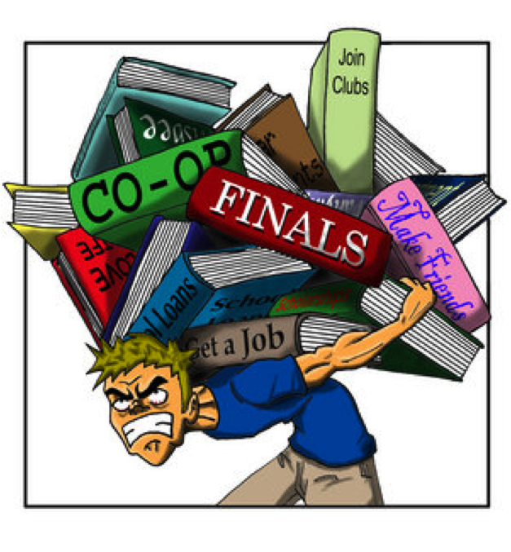
Building Resilience 1
Managing my stress
This programme aims to provide understanding of how feelings, thoughts and behaviour interact to produce common difficulties, and learn strategies to manage these difficulties, so that you can tackle these challenges with greater confidence in your abilities to cope and thrive.

Slide 2
What is stress?
Stress is the feeling of being under too much mental or emotional pressure.
Pressure turns into stress when you feel unable to cope.
(From NHS website)

Slide 3
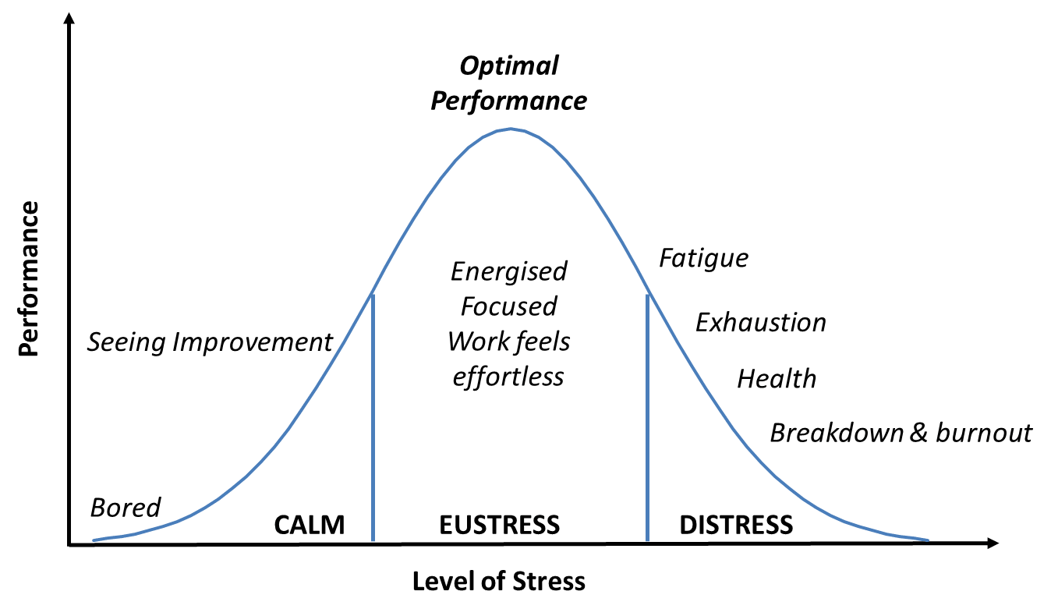
Yerkes Dodson Stress Curve
From www.projecttimes.com

Slide 4
What causes stress?
Increased stress is often associated with:
Times of change - starting or leaving university.
Circumstances where we feel we have limited control - exam timetables,
course deadlines, conflicts with flatmates.
When several factors coincide. ‘The straw that breaks the camel’s back’.
e.g. When family illness happens at exam time or an important relationship
breaks down when a dissertation is due.

Slide 5
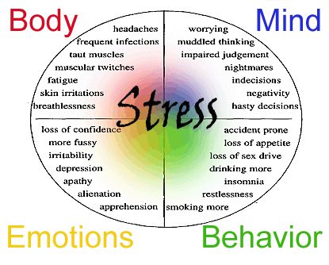
Stress affects:
Our bodies
Our minds
Our feelings
Our behaviour

Slide 6
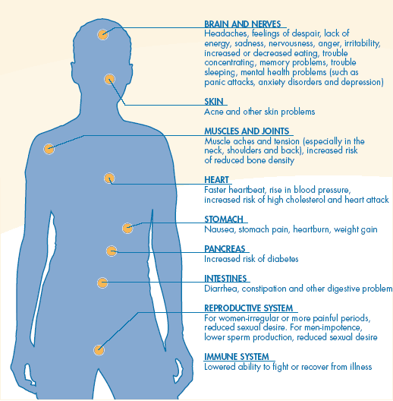
What happens in our bodies?

Slide 7
What happens in our minds?
We may find ourselves:
struggling to concentrate or retain information;
forgetting things or making mistakes;
finding it hard to make decisions, becoming confused;
finding it hard to plan ahead or problem solve effectively;
adopting rigid thought patterns in an effort to cope;
worrying and prone to ruminate unproductively about our problems;
becoming self critical;
feeling as though our thoughts are racing and we can’t switch off.
In these circumstances studying becomes very challenging as our higher cognitive capacities are not ‘on line’.

Slide 8
What happens in our feelings?
We may find ourselves:
irritated and easily drawn into conflict with others.
tearful and unhappy.
apathetic and agitated.
feeling bad about ourselves.

Slide 9
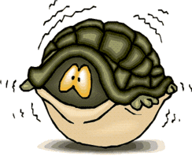
What happens in our behaviour?
We may find ourselves:
avoiding the problem as it feels too overwhelming -’burying your head in the sand’;
withdrawing from social contact and leisure activities;
studying for longer and longer periods without achieving anything;
taking it out on others;
denying the problem so avoiding asking for support;
becoming less organised and struggling to manage time effectively;
eating too much or too little;
smoking/drinking/using mind altering substances more than usual.

Slide 10
Funnel of Exhaustion. (Professor Marie Asberg)
The Funnel of Exhaustion diagram illustrates the way that we tend, when stressed, to drop our ‘optional’ activities to focus on what we see as necessary priorities.
We often stop doing things which resource us, thereby making our lives narrower and narrower and thereby increasing our stress levels.

Slide 11
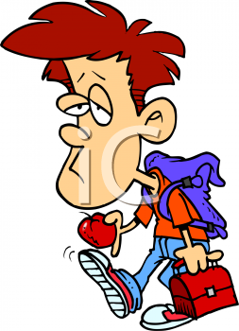
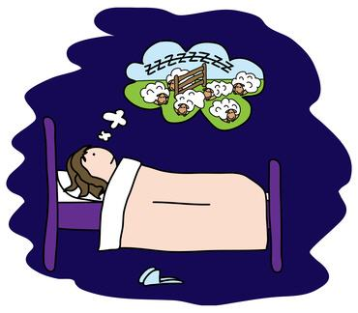
Is Stress Harmful?
Short term stress is generally not harmful to health and can motivate us to achieve.
But periods of prolonged stress can eventually contribute to serious health problems like:
Depression and anxiety Weight problems Auto immune diseases Skin conditions, such as eczema Reproductive issues | Heart disease Digestive problems Sleep problems Cognitive and memory problems

Slide 12
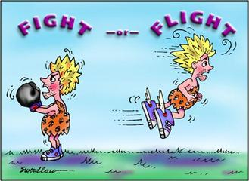
Fight/Flight/Freeze response
When we are highly stressed our threat detection system, a part of the brain called the Amygdala, detects a threat to our well being and our “Flight/Fight/Freeze response” is initiated instantly. Our bodies flood with the stress hormones- adrenaline and cortisol to prime us for action.
In 21st Century life stress rarely requires instant, vigorous action which would expend these hormones. More often they remain in the body giving us unpleasant physical and emotional symptoms in the short term and more serious health consequences if stress becomes chronic or prolonged.

Slide 14
Strategies for Managing Stress

Slide 15
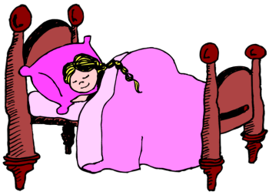
Get the basics right
Sleep- having enough sleep is important-everything is much harder when we are tired. We need sleep to consolidate learning.
Think about:
Having a good wake/sleep pattern.
Avoid working in bed-separate work/sleep spaces. Put work away when finished.
Short naps can be very helpful, but not too long and not near bedtime.
Creating a bedtime routine to cue your mind and body to sleep.
One step I can make to improve my sleep is…….

Slide 16
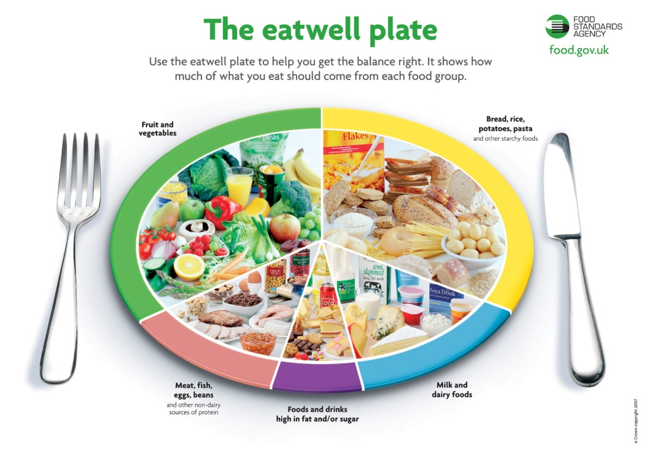
2. Eating- a healthy diet is vital to enable our brains to work effectively.
Think about;
Making sure to have breakfast to give you energy for the day ahead.
Trying not to skip meals-eat regularly to avoid lows and highs in blood sugar.
Try to limit fast food.
Eat some fruit or veg every day.
Try not to overload on caffeine.
One step I can make to improve my eating is……..

Slide 17
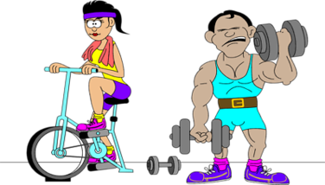
3. Alcohol and Drugs
Think about your use of mind altering substances.
Use moderately and with care for yourself.
4. Exercise- a regular pattern of physical exercise is an effective de-stressor. It uses up stress hormones, reduces symptoms and releases endorphins, the brain’s happy chemicals.
Think about:
Building exercise into your routine- walk or cycle to lectures.
Join a sports club.
Go to the gym with friends.
Go to an exercise class.
One step I can make to improve how much I exercise is…….

Slide 18
5. A balanced life-
Seeing friends, having fun, keeping in touch with family, maintaining interests and hobbies are all important. They help us to replenish our energies and function effectively.
One step I can make towards having a more balanced life is………

Slide 19
Reduce the Pressure we put on ourselves
Pressure can be:
External - exams, deadlines, financial worries,
others expectations.
Internal - perfectionism, self criticism,
anxious thinking.
To reduce internal pressure we can:
Develop ways of encouraging ourselves.
Aim to do OUR best not be THE best.
Allow ourselves to make mistakes.
Watch out for ‘What if’ thinking.
Be kind and supportive towards ourselves

Slide 20
Develop a good support system
Having strong connections with others and experiencing their care and support helps to prevent chronic and overwhelming stress and to alleviate stressful episodes.
Think about:
Asking for help and support when you need it from:
Friends and family;
Tutors, Student Services, Study Skills, other University services;
Local services-GP.
Making sure to spend time with people close to you even when time is short.

Slide 21
Improve your planning and organisation
Aim to work effectively and use time efficiently-quality not quantity.
Consider;
List and rate your tasks in order of importance.
Make a timetable - allocate time to tasks reflecting their value -
don’t get bogged down on small things.
Know what is your best time of day - do hardest tasks then.
Do routine tasks when you have less energy e.g. filing, organising notes.
With assessed work play the percentage game -
the first 50% of marks are the easiest to get!
Take regular breaks - if you find you are not achieving anything take a break and come back to it refreshed.
Build in rewards- things to look forward to.

Slide 22
Learn relaxation techniques
Relaxation is the natural answer to stress. The relaxation response activates the Parasympathetic Nervous System, which acts to reverse the changes of the Sympathetic Nervous System (Fight/Flight Freeze) activated by stress.
Some relaxation techniques include:
Breathing- when we are stressed we have a tendency to take shallow breaths, using only the top part of our chests to breathe and not our stomach muscles.
Learning to breathe more deeply can help us feel a lot calmer.
Making out-breaths longer than in-breaths is especially calming.
Different types of whole body relaxation –
Progressive muscular relaxation and using imagery to relax.
Come and learn these techniques at our workshop -
‘Ican improve my well-being and learn to relax’

Slide 23
My Personal Stress Reduction Plan:
Where am I on the Stress curve right now?
How can I get to where I need to be?
My first step will be……..
When I will do it…….
What support will I need to do this…………..

Slide 24
Resources available:
Use support systems available within the University -
Academic support - Personal tutors; Subject tutors; Dyslexia Service; Study Skills Service.
Student Support - Disability Services; Money Support.
Student Union services.
Learn more about stress and ways to overcome it -
Attend Building Resilience lectures - see Counselling Service website.
Learn Mindfulness Meditation.
Look at self–help links on Counselling Service website.
Consult on line resource.
This Workshop attracts BEA points

